Slide 1
Deadlocks

Slide 2
Deadlocks
System Model
Deadlock Characterization
Methods for Handling Deadlocks
Deadlock Prevention
Deadlock Avoidance
Deadlock Detection
Recovery from Deadlock

Slide 3
System model
Finite number of resources , distributed among a number of compitative processes.
Resources may be partitioned upto several types(HW types,SW types).
Ex. CPU types, printer types
if there are 4 printers then there are 4 instances of types printer.

Slide 4
System Model
System consists of resources
Resource types R₁, R₂, . . ., R_{m}
CPU cycles, memory space, I/O devices
Each resource type R_{i} has W_{i} instances.
Each process utilizes a resource as follows:
request
use
release

Slide 5
Deadlock
One process Pi holds Printer and Pj holds DVD writer.
Pi request for DVD writer and Pj request for printer.

Slide 6
Deadlock Characterization
Deadlock can arise if four conditions hold simultaneously.
Mutual exclusion: only one process at a time can use a resource
Hold and wait: a process holding at least one resource is waiting to acquire additional resources held by other processes

Slide 7
No preemption: a resource can be released only voluntarily by the process holding it, after that process has completed its task
Circular wait: there exists a set {P₀, P₁, …, P_{n}} of waiting processes such that P₀ is waiting for a resource that is held by P₁, P₁ is waiting for a resource that is held by P₂, …, P_{n–1} is waiting for a resource that is held by P_{n}, and P_{n} is waiting for a resource that is held by P₀.

Slide 8
Resource allocation graph
Deadlock can be described more precisely in terms of a directed graph called a system resource-allocation graph.
The set of vertices V is partitioned into two different types of nodes.
P={ P1, P2, ... , Pn}
R={ R1, R2, ... ,Rn}

Slide 9
Resource-Allocation Graph
A set of vertices V and a set of edges E.
V is partitioned into two types:
P = {P₁, P₂, …, P_{n}}, the set consisting of all the processes in the system
R = {R₁, R₂, …, R_{m}}, the set consisting of all resource types in the system
request edge – directed edge P_{i} → R_{j}
assignment edge – directed edge R_{j} → P_{i}

Slide 10
Resource-Allocation Graph (Cont.)
Process Resource Type with 4 instances
P_{i} requests instance of R_{j}
P_{i} is holding an instance of R_{j}
P_{i}
R_{j}
P_{i}
R_{j}

Slide 11
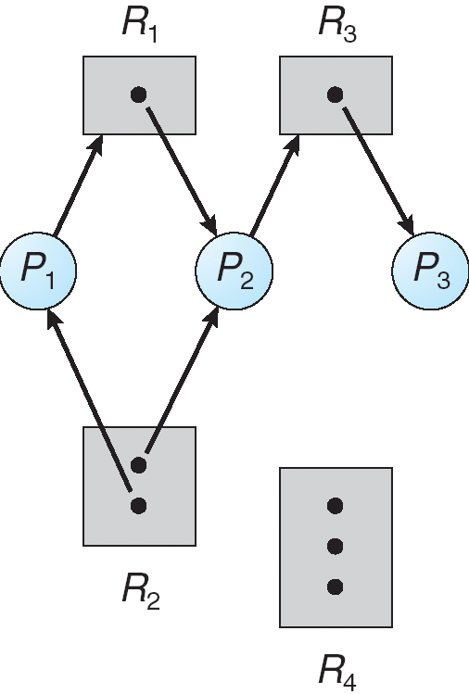
Example of a Resource Allocation Graph

Slide 12
Resource allocation graph
Given the resource allocation graph if graph has no cycle, then no process in the system is in deadlock.
If it contains cycle then deadlock may exist.
if each resource type has exactly one instance, then cycle implies that a deadlock has occured.

Slide 13
In this case a cycle in the graph is both a necessary and sufficient condition for the existance of deadlock.
if each resource type has several instances , then a cycle in the graph is a necessary condition but not sufficient condition for the existance of deadlock.

Slide 14
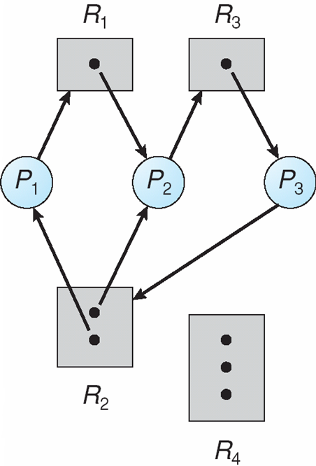
Resource Allocation Graph With A Deadlock

Slide 15
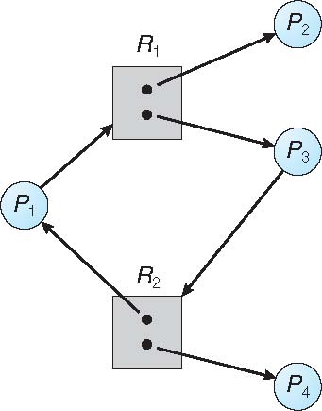
Graph With A Cycle But No Deadlock

Slide 16
Basic Facts
If graph contains no cycles ⇒ no deadlock
If graph contains a cycle ⇒
if only one instance per resource type, then deadlock
if several instances per resource type, possibility of deadlock

Slide 17
Methods for Handling Deadlocks
Ensure that the system will never enter a deadlock state:
Deadlock prevention
Deadlock avoidence
Allow the system to enter a deadlock state and then recover
Ignore the problem and pretend that deadlocks never occur in the system; used by most operating systems, including UNIX

Slide 18
Deadlock Prevention
For a deadlock to occur , each of the four necessary conditions must hold.
By ensuring that at least one of these condtitions cannot hold, the occurance of deadlock can be prevented.
Mutual Exclusion – not required for sharable resources (e.g., read-only files); must hold for non-sharable resources.

Slide 19
Deadlock Prevention
Restrain the ways request can be made
Hold and Wait – must guarantee that whenever a process requests a resource, it does not hold any other resources
Require process to request and be allocated all its resources before it begins execution, or allow process to request resources only when the process has none allocated to it.
Low resource utilization; starvation possible

Slide 20
Two protocols
It needs that each process must request and be allocated all its resources before it begins execution.
i.e the systems call for resource request must preceed all other system calls.
Next protocol allows a process to request resources only when it has none.
A process may request some resources use them , before it can request any aditional resource.

Slide 21
the third necessary condition for deadlocks is that there will be no preemption of resources that have already been allocated.
to ensure this condition, the following protocols can be used:
if a process is holding some request and request for another resource which is not available then all its current resource are preempted.
if it request for resource which is hold by some other process that is waiting for additional resource then the desired resources are preempted from the waiting process and allocated to it else oll its resources are preempted.

Slide 22
Deadlock Prevention (Cont.)
No Preemption –
If a process that is holding some resources requests another resource that cannot be immediately allocated to it, then all resources currently being held are released
Preempted resources are added to the list of resources for which the process is waiting
Process will be restarted only when it can regain its old resources, as well as the new ones that it is requesting
Circular Wait – impose a total ordering of all resource types, and require that each process requests resources in an increasing order of enumeration

Slide 23
circular wait
to ensure that this condition never holds
ordering of resources are done.
Ex. F(tape drive)=1
F(disk drive)=5
F(printer)=10
i.e each resource type is assigned with a unique integer number. F:R->N
To prevent deadlock: Protocol is each process can request resources only in increasing order of inumeration.

Slide 24
...
initially it can request for any number of resource type.
Ex.if a process holds resource Ri then it can request for Rj only when F(Ri)< F(Rj).
if not then it must release Ri then request for Rj.
if this protocol is used then circular wait can not be hold.

Slide 25
Deadlock Avoidance
Requires that the system has some additional a priori information available
Limitation of prevention:
Low device utilization and reduced system throughput.
Deadlock avoidance,system will never enter into a deadlock system.
Simplest and most useful model requires that each process declare the maximum number of resources of each type that it may need

Slide 26
...
The deadlock-avoidance algorithm dynamically examines the resource-allocation state to ensure that there can never be a circular-wait condition
Resource-allocation state is defined by the number of available and allocated resources, and the maximum demands of the processes

Slide 27
Safe State
When a process requests an available resource, system must decide if immediate allocation leaves the system in a safe state
System is in safe state if there exists a sequence <P₁, P₂, …, P_{n}> of ALL the processes in the systems such that for each P_{i}, the resources that P_{i} can still request can be satisfied by currently available resources + resources held by all the P_{j}, with j < i

Slide 28
That is:
If P_{i} resource needs are not immediately available, then P_{i} can wait until all P_{j} have finished
When P_{j} is finished, P_{i} can obtain needed resources, execute, return allocated resources, and terminate
When P_{i} terminates, P_{i +1} can obtain its needed resources, and so on

Slide 29
Example:
Total resourses :12
Proceses :P0,P1,P2
Maximum needs: 10,4,9
Current Needs: 5,2,2
safe state :safe sequence <P1,P0,P2>

Slide 30
Unsafe state
Lets at time t1, P2 is assigned with one more drive. Then ...
only P1 can be allocated with all its drives.
P0 may request for 5 more and wait.
P2 may request for 6 more and wait
resulting in deadlock state.
mistake is :assignment of 1 resource to P2.
If we had made P2 wait until other processes finish then we could have avoided deadlock.

Slide 31
Basic Facts
If a system is in safe state ⇒ no deadlocks
If a system is in unsafe state ⇒ possibility of deadlock
Avoidance ⇒ ensure that a system will never enter an unsafe state.

Slide 32
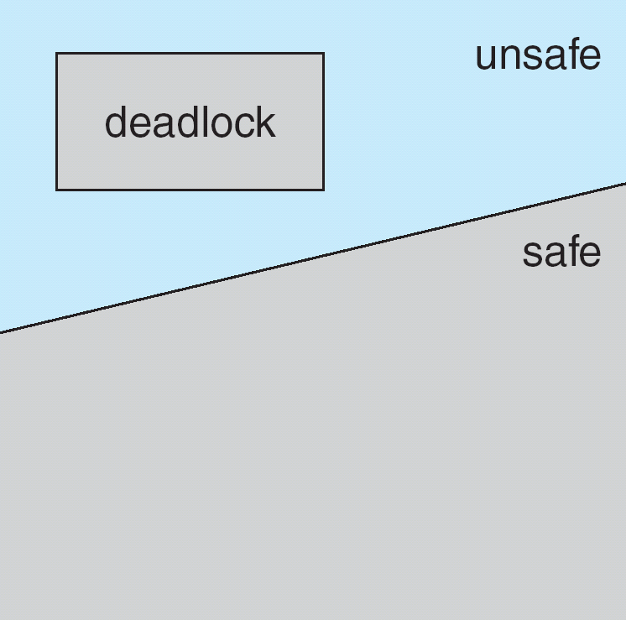
Safe, Unsafe, Deadlock State

Slide 33
...
Given the concept of safe state , we can have avoidance algorithms that ensure that the system will never deadlock.
Idea: The system is in a safe state. Whenever a process requests a resource that is currently available, the system must decide whether the resource can be allocated immediately or whether the process must wait.
the request is grant only if the aloocation leaves the system in a safe state.

Slide 34
Avoidance Algorithms
Single instance of a resource type
Use a resource-allocation graph
Multiple instances of a resource type
Use the banker’s algorithm

Slide 35
Resource-Allocation Graph Scheme
Claim edge P_{i} → R_{j} indicated that process P_{j} may request resource R_{j}; represented by a dashed line
Claim edge converts to request edge when a process requests a resource

Slide 36
...
Request edge converted to an assignment edge when the resource is allocated to the process
When a resource is released by a process, assignment edge reconverts to a claim edge
Resources must be claimed a priori in the system

Slide 37
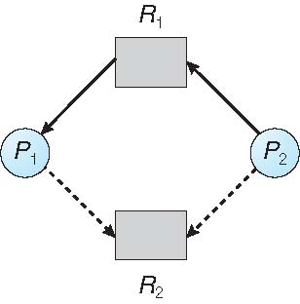
Resource-Allocation Graph

Slide 38
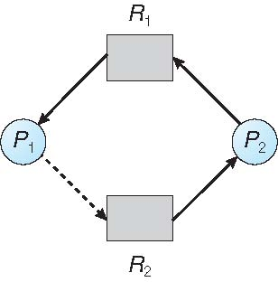
Unsafe State In Resource-Allocation Graph

Slide 39
Resource-Allocation Graph Algorithm
Suppose that process P_{i} requests a resource R_{j}
The request can be granted only if converting the request edge to an assignment edge does not result in the formation of a cycle in the resource allocation graph

Slide 40
Banker’s Algorithm
Multiple instances
Each process must a priori claim maximum use
this number may not exceed the total number of resources in a system.

Slide 41
...
When a process requests a resource the system must determine whether the allocation of the resources will leave the system in safe state.
if it will, the resources are allocated otherwise, the process must wait untill some other proces releases enough resource.
When a process gets all its resources it must return them in a finite amount of time.

Slide 42
Data Structures for the Banker’s Algorithm
Let n = number of processes, and m = number of resources types.
Available: Vector of length m. If available [j] = k, there are k instances of resource type R_{j} available
Max: n x m matrix. If Max [i,j] = k, then process P_{i} may request at most k instances of resource type R_{j}

Slide 43
...
Allocation: n x m matrix. If Allocation[i,j] = k then P_{i} is currently allocated k instances of R_{j}
Need: n x m matrix. If Need[i,j] = k, then P_{i} may need k more instances of R_{j} to complete its task
Need [i,j] = Max[i,j] – Allocation [i,j]

Slide 44
Safety Algorithm
1. Let Work and Finish be vectors of length m and n, respectively. Initialize:
Work = Available
Finish [i] = false for i = 0, 1, …, n- 1
2. Find an i such that both:
(a) Finish [i] = false
(b) Need_{i} ≤ Work
If no such i exists, go to step 4

Slide 45
3. Work = Work + Allocation_{i} Finish[i] = true go to step 2
4. If Finish [i] == true for all i, then the system is in a safe state

Slide 46
Resource-Request Algorithm for Process P_{i}
Request_{i} = request vector for process P_{i}. If Request_{i} [j] = k then process P_{i} wants k instances of resource type R_{j}
1. If Request_{i} ≤ Need_{i} go to step 2. Otherwise, raise error condition, since process has exceeded its maximum claim
2. If Request_{i} ≤ Available, go to step 3. Otherwise P_{i} must wait, since resources are not available

Slide 47
3. Pretend to allocate requested resources to P_{i} by modifying the state as follows:
Available = Available – Request_{i};
Allocation_{i} = Allocation_{i} + Request_{i};
Need_{i} = Need_{i} – Request_{i};
If safe ⇒ the resources are allocated to P_{i}
If unsafe ⇒ P_{i} must wait, and the old resource-allocation state is restored

Slide 48
Example of Banker’s Algorithm
5 processes P₀ through P₄;
3 resource types:
A (10 instances), B (5instances), and C (7 instances)
Snapshot at time T₀:
Allocation Max Available
A B C A B C A B C
P₀ 0 1 0 7 5 3 3 3 2
P₁ 2 0 0 3 2 2
P₂ 3 0 2 9 0 2
P₃ 2 1 1 2 2 2
P₄ 0 0 2 4 3 3

Slide 49
Example (Cont.)
The content of the matrix Need is defined to be Max – Allocation
Need
A B C
P₀ 7 4 3
P₁ 1 2 2
P₂ 6 0 0
P₃ 0 1 1
P₄ 4 3 1
The system is in a safe state since the sequence < P₁, P₃, P₄, P₂, P₀> satisfies safety criteria

Slide 50
Example: P₁ Request (1,0,2)
Check that Request ≤ Available (that is, (1,0,2) ≤ (3,3,2) ⇒ true
Allocation Need Available
A B C A B C A B C
P₀ 0 1 0 7 4 3 2 3 0
P₁ 3 0 2 0 2 0
P₂ 3 0 2 6 0 0
P₃ 2 1 1 0 1 1
P₄ 0 0 2 4 3 1

Slide 51
Executing safety algorithm shows that sequence < P₁, P₃, P₄, P₀, P₂> satisfies safety requirement
Can request for (3,3,0) by P₄ be granted?
Can request for (0,2,0) by P₀ be granted?

Slide 52
Deadlock Detection
Allow system to enter deadlock state
Detection algorithm
Recovery scheme

Slide 53
Single Instance of Each Resource Type
Maintain wait-for graph
Nodes are processes
P_{i} → P_{j} if P_{i} is waiting for P_{j}
Periodically invoke an algorithm that searches for a cycle in the graph. If there is a cycle, there exists a deadlock
An algorithm to detect a cycle in a graph requires an order of n² operations, where n is the number of vertices in the graph

Slide 54
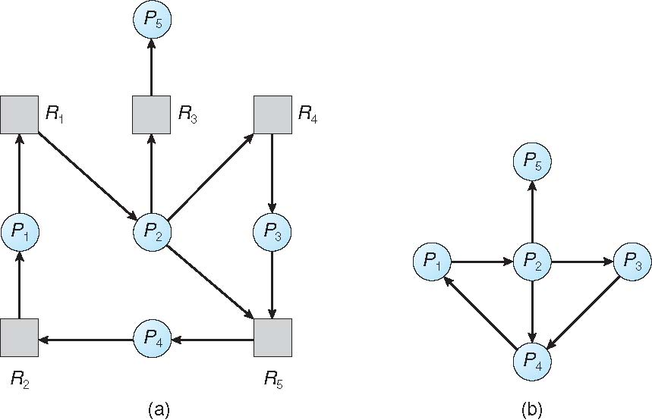
Resource-Allocation Graph and Wait-for Graph
Resource-Allocation Graph
Corresponding wait-for graph

Slide 55
Several Instances of a Resource Type
Available: A vector of length m indicates the number of available resources of each type
Allocation: An n x m matrix defines the number of resources of each type currently allocated to each process
Request: An n x m matrix indicates the current request of each process. If Request [i][j] = k, then process P_{i} is requesting k more instances of resource type R_{j}.

Slide 56
Detection Algorithm
1. Let Work and Finish be vectors of length m and n, respectively Initialize:
(a) Work = Available
(b) For i = 1,2, …, n, if Allocation_{i} ≠ 0, then Finish[i] = false; otherwise, Finish[i] = true
2. Find an index i such that both:
(a) Finish[i] == false
(b) Request_{i} ≤ Work
If no such i exists, go to step 4

Slide 57
Detection Algorithm (Cont.)
3. Work = Work + Allocation_{i} Finish[i] = true go to step 2
4. If Finish[i] == false, for some i, 1 ≤ i ≤ n, then the system is in deadlock state. Moreover, if Finish[i] == false, then P_{i} is deadlocked
Algorithm requires an order of O(m x n²) operations to detect whether the system is in deadlocked state

Slide 58
Example of Detection Algorithm
Five processes P₀ through P₄; three resource types A (7 instances), B (2 instances), and C (6 instances)
Snapshot at time T₀:
Allocation Request Available
A B C A B C A B C
P₀ 0 1 0 0 0 0 0 0 0
P₁ 2 0 0 2 0 2
P₂ 3 0 3 0 0 0
P₃ 2 1 1 1 0 0
P₄ 0 0 2 0 0 2
Sequence <P₀, P₂, P₃, P₁, P₄> will result in Finish[i] = true for all i

Slide 59
Example (Cont.)
P₂ requests an additional instance of type C
Request
A B C
P₀ 0 0 0
P₁ 2 0 2
P₂ 0 0 1
P₃ 1 0 0
P₄ 0 0 2
State of system?
Can reclaim resources held by process P₀, but insufficient resources to fulfill other processes; requests
Deadlock exists, consisting of processes P₁, P₂, P₃, and P₄

Slide 60
Detection-Algorithm Usage
When, and how often, to invoke depends on:
How often a deadlock is likely to occur?
How many processes will need to be rolled back?
one for each disjoint cycle
If detection algorithm is invoked arbitrarily, there may be many cycles in the resource graph and so we would not be able to tell which of the many deadlocked processes “caused” the deadlock.

Slide 61
Recovery from Deadlock: Process Termination
Abort all deadlocked processes
Abort one process at a time until the deadlock cycle is eliminated
In which order should we choose to abort?
Priority of the process
How long process has computed, and how much longer to completion
Resources the process has used
Resources process needs to complete
How many processes will need to be terminated
Is process interactive or batch?

Slide 62
Recovery from Deadlock: Resource Preemption
Selecting a victim – minimize cost
Rollback – return to some safe state, restart process for that state
Starvation – same process may always be picked as victim, include number of rollback in cost factor

Slide 63
End of Chapter 7

